Slide 1


Ayiti Analytics Bootcamp
Fraudulent Credit cards Transaction.
Boutique sales products Analysis
Linxsly ALEXIS
Matteucci Cyril
Gothie Ridgina PASTEUR

Slide 2
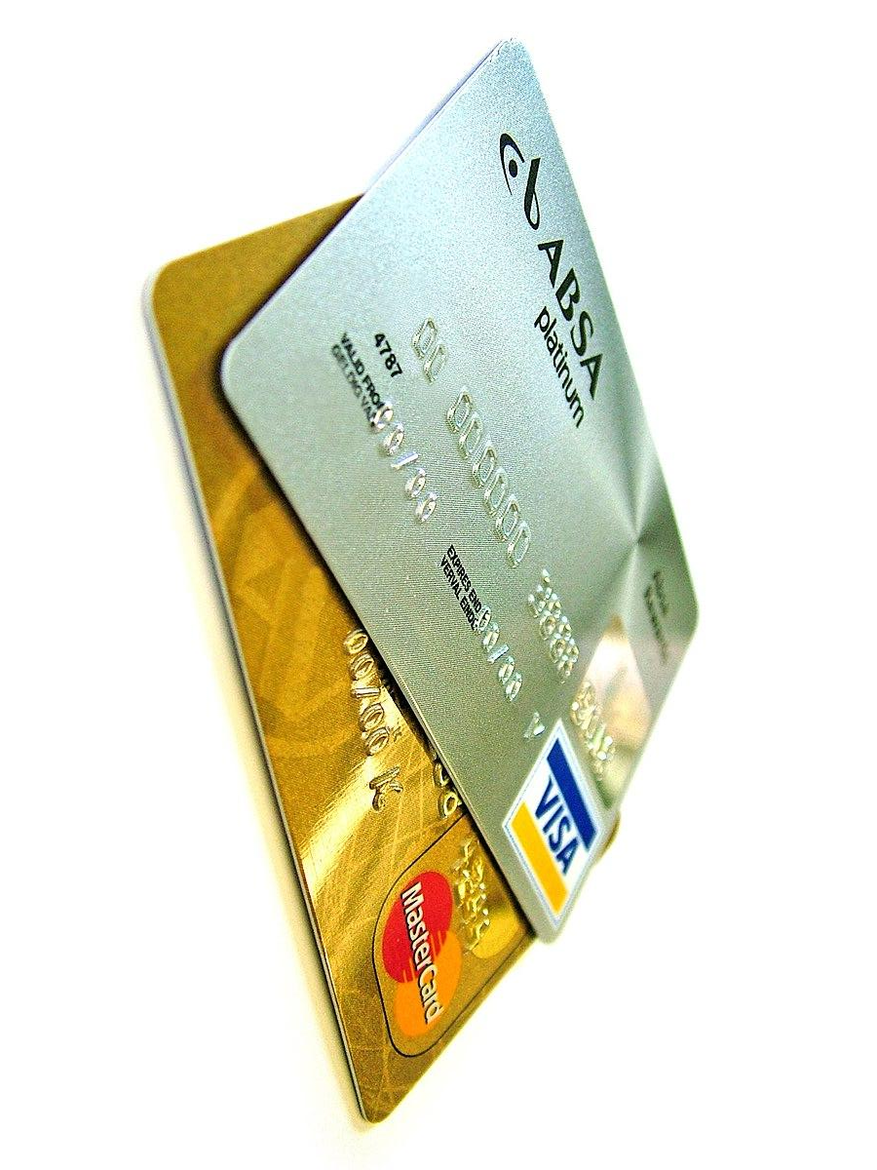
Introduction
The general management of the bank, concerned about the experience of its customers who often complain about the fact that some transactions were made on their credit card without their authorization, and also about the new newspapers that keep saying that the bank does nothing to secure the money of the customers, contacted us to help them solve this problem of fraud that decreases the confidence of customers in their system.

Slide 3

Problem
Defined the problem
The problem is that bank customers complain about fraud on their accounts where they lose large sums of money from their credit cards and despite complaints brought to the media.

Slide 4

Stakeholders
Clients
It affects customers because due to the bank’s lack of responsibility they lose large sums of money.
The bank
It affects the bank because their complaints can make them lose to their customers and make them unable to find new customers.
The Media

Slide 5
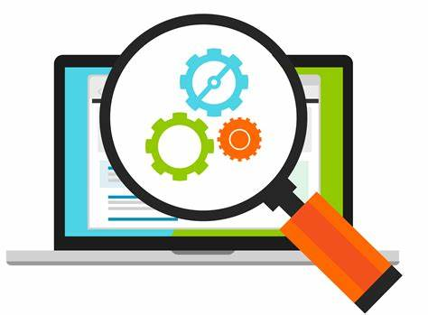
To realize this work :
we used the data given to us by the bank.
Then we did the processing , analysis and graph of the data using python (pandas, numpy, scipy, seaborn, matplotlib).
We looked at transactions by gender, category and merchant to see if there was one group more likely to be defrauded than another
Google slides
Result
With all the data we have received after analyze them we will identity the problem and bring some solutions.
Methodology

Slide 6
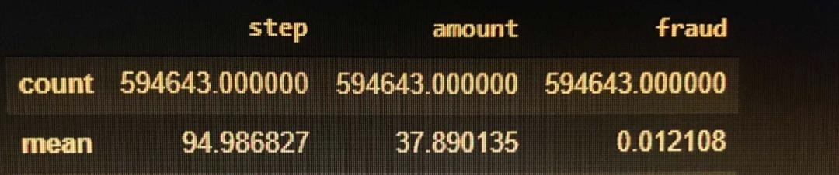
Results
Summary statistic of the data

Slide 7
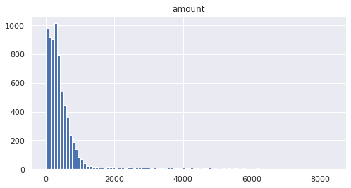
Distribution of fraud by amount
The data shows that there are more than 6000 amounts that are fraudulent between 0 and 2000 $.

Slide 8
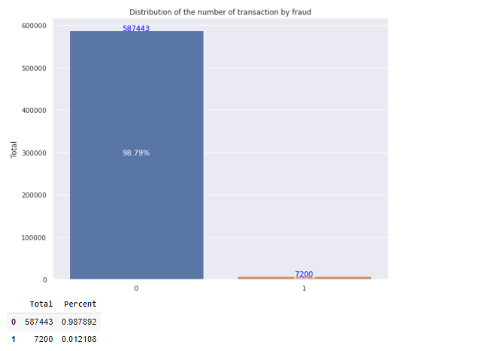
Distribution of the transactions by fraud
On 594643, the percentage of fraud represent 1,21% .

Slide 9
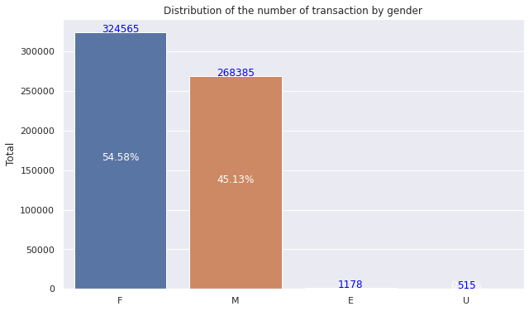
Distribution of the number of transaction by gender
As we can see, this graph shows that The female make more than 50% of transactions. It's higher than the middle. It's relevant because we can notice that women use their credit cards more than men.

Slide 10
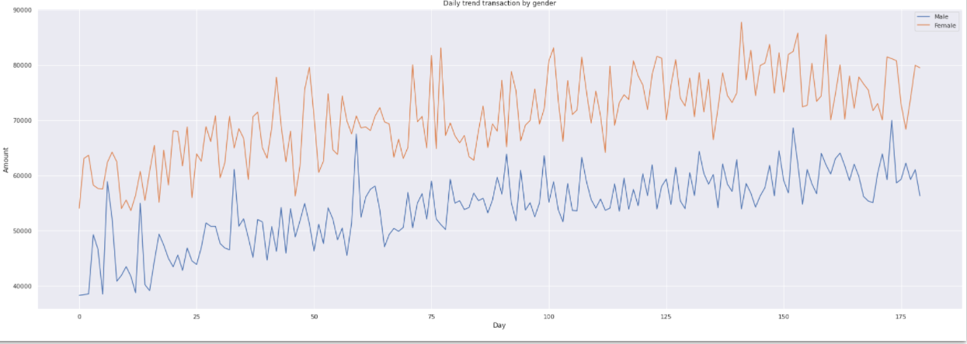
Daily trend transaction by gender
The data show that women tends to purchase more than men. The trend is increasing for the two genders. None of them seems to reduce their purchases for the whole time.

Slide 11
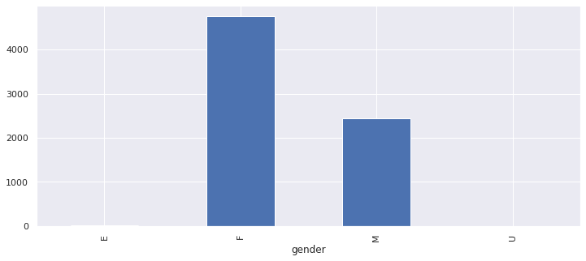
Distribution of fraud between male and female
Women are most susceptible to be victims of fraud. On each 1000 transactions made by a female, 14.6 are fraudulent.

Slide 12
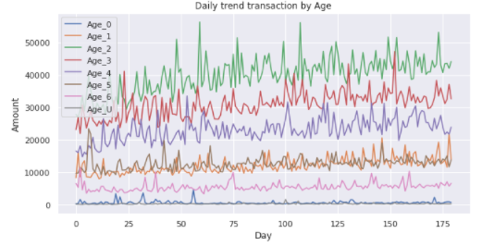
Daily trend by age
This graph shows that the persons who are in range 26-35 , 36- 45 years old are more susceptible to be victim of fraud.

Slide 13
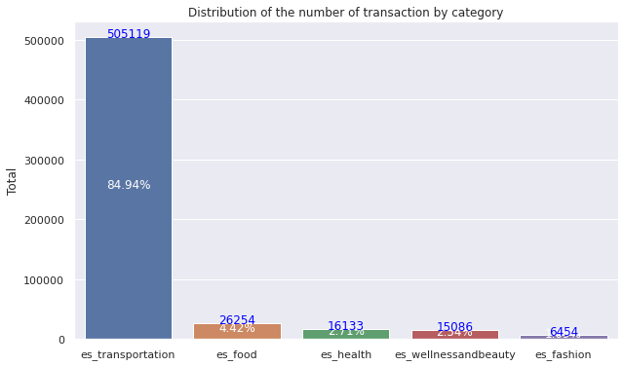
Distribution of transactions by category
The transportation category represent more than 80 % transaction of the all category

Slide 14
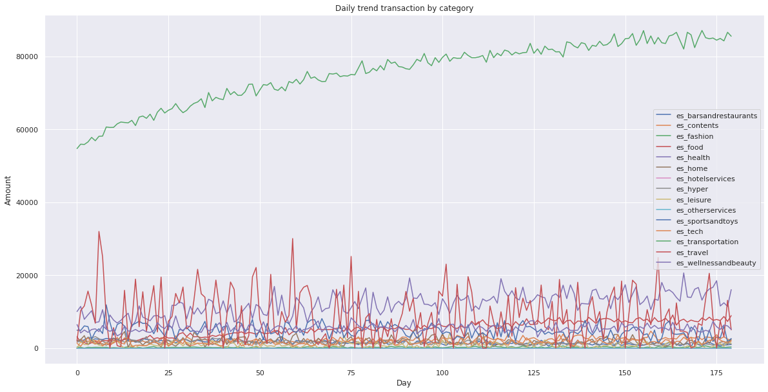
Daily trend transaction by category
As we can see , the daily trend for transport is growing and it is higher than other in amount. Its increasing. That’s mean they are too many transactions in this category.

Slide 15
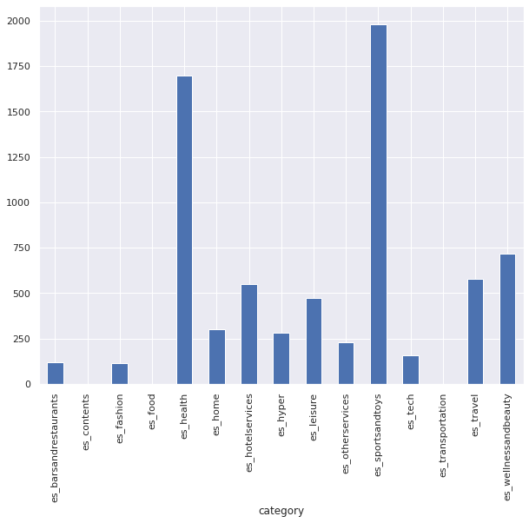
Distribution by category victim of fraud
Leisure is the category which is the most susceptible to be a victim of fraud. On each 100 transactions made by a female, 94.99 are fraudulent.

Slide 16
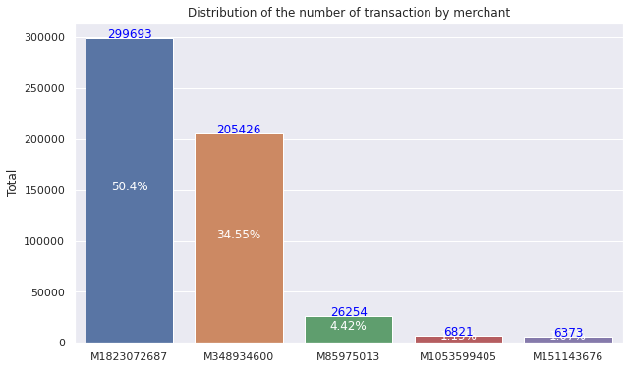
Distribution of the transaction by merchants
This graph shows the distribution of the transactions by merchant. As we can notice, the frequency of the merchant "M1823072687" is 50.39% and the merchant "M348934600" represents 34.54% of the transactions. We can conclude that more than 84% of the transactions have been registered by these merchants.

Slide 17
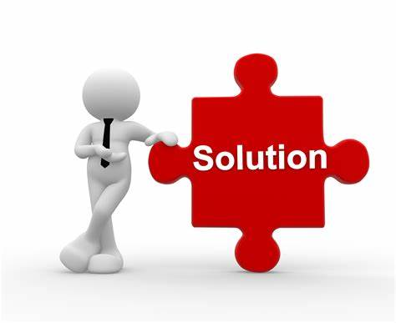
Proposed Solution
Based on the insights provided by the data processing we did, we can now propose better solution to regain clients trust.
1- Among the transactions of 2000 dollars and more, only one is not a fraud object so they should stop for a while all transactions over 2000 dollars.
2-Implementing a reliable security system and increasing control over credit card transactions

Slide 18
1- Among the transactions of 2000 dollars and more, only one is not a fraud object so they should stop for a while all transactions over 2000 dollars.
STRENGTHS
WEAKNESSES
CHALLENGES
Enable good internal fraud management
Dissatisfaction of a group of customers
Decrease of profit
Retaining customers who are victims of fraud and customers who are suspected of committing fraud

Slide 19
2-Implementing a reliable security system and increasing control over credit card transactions
STRENGTHS
WEAKNESSES
CHALLENGES
Improve the security systems
Possibility to increase the number of clients looking for reliable management systems
Increase of expenses
Good marketing to counteract bad publicity

Slide 20

Our thoughts on the fraudulent transactions
I think that the fraudulent transactions depends on variables. The CHI_2 Test shows that clearly. That means there is a specific gender, category, merchant which are more susceptible to be victim of fraud.
In terms of gender, women are more likely to be victims of fraud. The target age is between 22 and 26 years old and the category concerns leisure

Slide 21
Recommendations
A validation code before each transaction that must be made on the card.
Receiving a message from the bank either by mail or by phone every time the customer is going to make a suspicious transaction
Set up a system to help customers control their accounts and identify merchants with a high percentage of fraud.
Report as fraud all transactions that follow the trend of fraudulent transactions and wait for the customer's opinion before authorizing the transaction.

Slide 22
Other Data and References
Additional data would be required on merchants (gender, age, address) and customers (length of time with the bank, they locations)
This additional data will help us to see if fraud is related to the gender of the merchants, and to their geographical location. Does the number of years of experience of customers in the bank
Bank Data
(PDF) BankSim: A Bank Payment Simulation for Fraud Detection Research (researchgate.net)

Slide 23
THANKS
Contact Me
I you have any question about this presentation, Feel free to send us a message in the #business-analysis channel on slack.
Ressources
https://github.com/gothie348/BI_project_2.git

